Slide 4
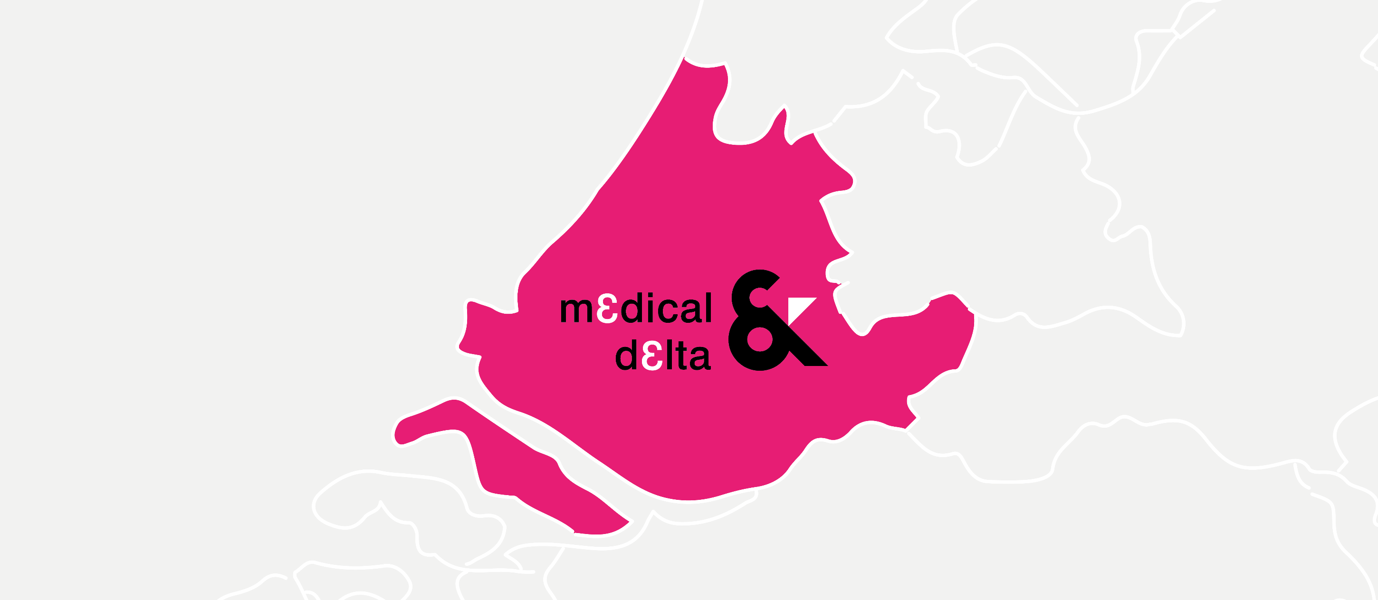
Map

Slide 5
Notes:
In this slide you can add a square photo. The photo will automatically be cropped to a size of 14.69 cm high and 16.96 cm wide.
Click on the icon and choose from your files which photo you want to use.

Slide 6
Notes:
You can add a portrait photo in this slide. The photo will automatically be cropped to a size of 14.69 cm high and 9.79 cm wide (ratio 15x10 cm)
Click on the icon and choose from your files which photo you want to use.

Slide 7
Notes:
In this slide you can add a full-frame landscape photo. The photo will automatically be cropped to a size of 14.69 cm high and 33.87 cm wide.
Click on the icon and choose from your files which photo you want to use.

Slide 8
Notes:
You can add 4 horizontal photos in this slide. The photo will automatically be cropped to a size of 7.3 cm high and 16.89 cm wide.
Click on the icon and choose from your files which photo you want to use.

Slide 9
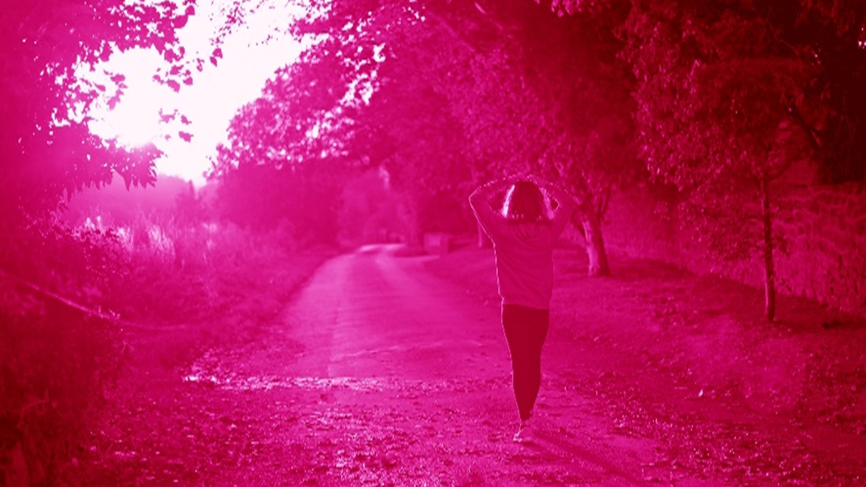
Thank you

