Slide 1
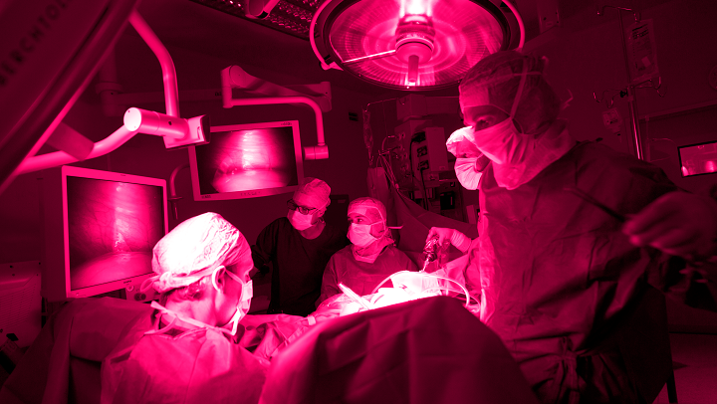

Slide 2



Medical Delta | Video

Slide 3
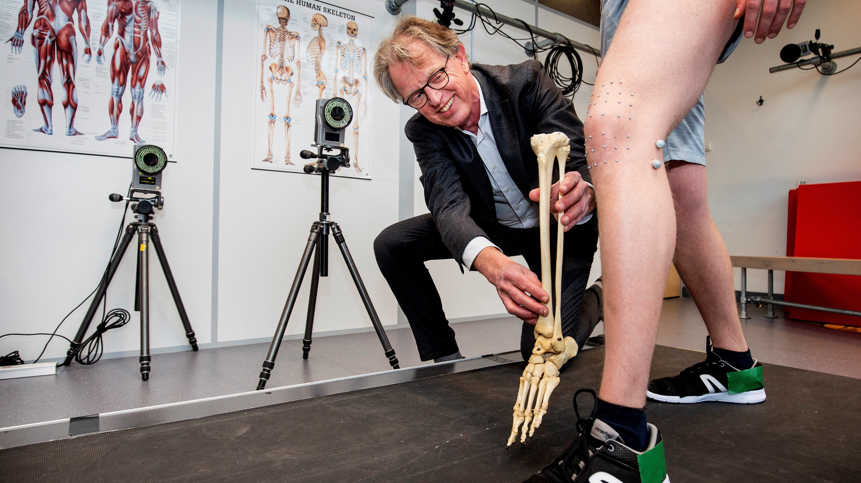
Medical Delta in short
Technological solutions for sustainable healthcare
Notes:
The average life expectancy in Europe continues to rise. Partly due to an aging population, the demand for care will increase in the coming years, as will the cost of care. At the same time, we want to live longer in good health. And that while there are fewer and fewer people who can provide care.
All this calls for a transition of care.
We believe that technological innovation plays a crucial role in this.
Medical Delta realizes technological solutions for sustainable care.

Slide 4
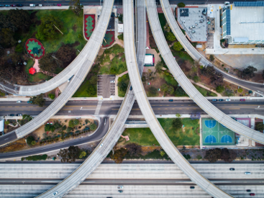

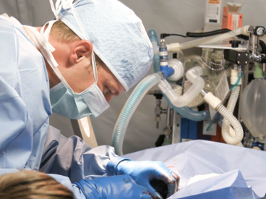
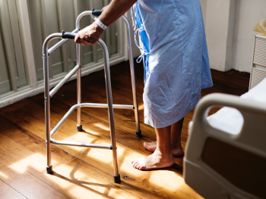

Medical Delta in short
Core Values
Interdisciplinairy
cooperation
Solution oriented
Scientific basis
Embedded in
healthcare practice
Focused on
accelerating
Notes:
Medical Delta is characterized by five core values:
Interdisciplinary cooperation. Since the establishment of Medical Delta in 2006, that has been the basis for everything we do: look at a problem together from different disciplines; the engineer helps the doctor solve a problem. Collaboration between disciplines leads to promising innovations.
Solution-oriented. All Medical Delta scientific programs have a clear goal. We do not investigate for investigation, but to solve actual problems.
Scientific basis. An important feature for Medical Delta. Everything we do is scientifically validated and is open to everyone.
Embedding in healthcare practice. In many studies, healthcare professionals or patients are closely involved - often right from the start. The universities of applied sciences, in particular, with their Living Labs, build a bridge to healthcare practice.
The activities of Medical Delta are always focused on accelerating. Whether it is about accelerating research, accelerating the process from prototype to clinical validation or testing innovations with practice partners. Acceleration takes place in the living labs, in the interdisciplinary research consortia and in the public-private consortia projects in which scientists, practice partners and companies work together.
These core values ​​form the basis since the start of Medical Delta, and will continue to be so in the coming years.

Slide 5

Medical Delta in short
⁵⁰⁰
^{Scientists}
¹⁶
^{Programs}
⁹
^{Living labs}
³²
^{Medical Delta}
^{Professors}
Notes:
Medical Delta was founded by the three universities and two academic medical centers in South Holland. The four universities of applied sciences joined later.
Around 280 researchers from different disciplines work closely together on thirteen scientific programs. They do this with, among other things, ten Medical Delta Labs.
This makes Medical Delta the hub of the Health & Technology ecosystem in the delta region.

Slide 6
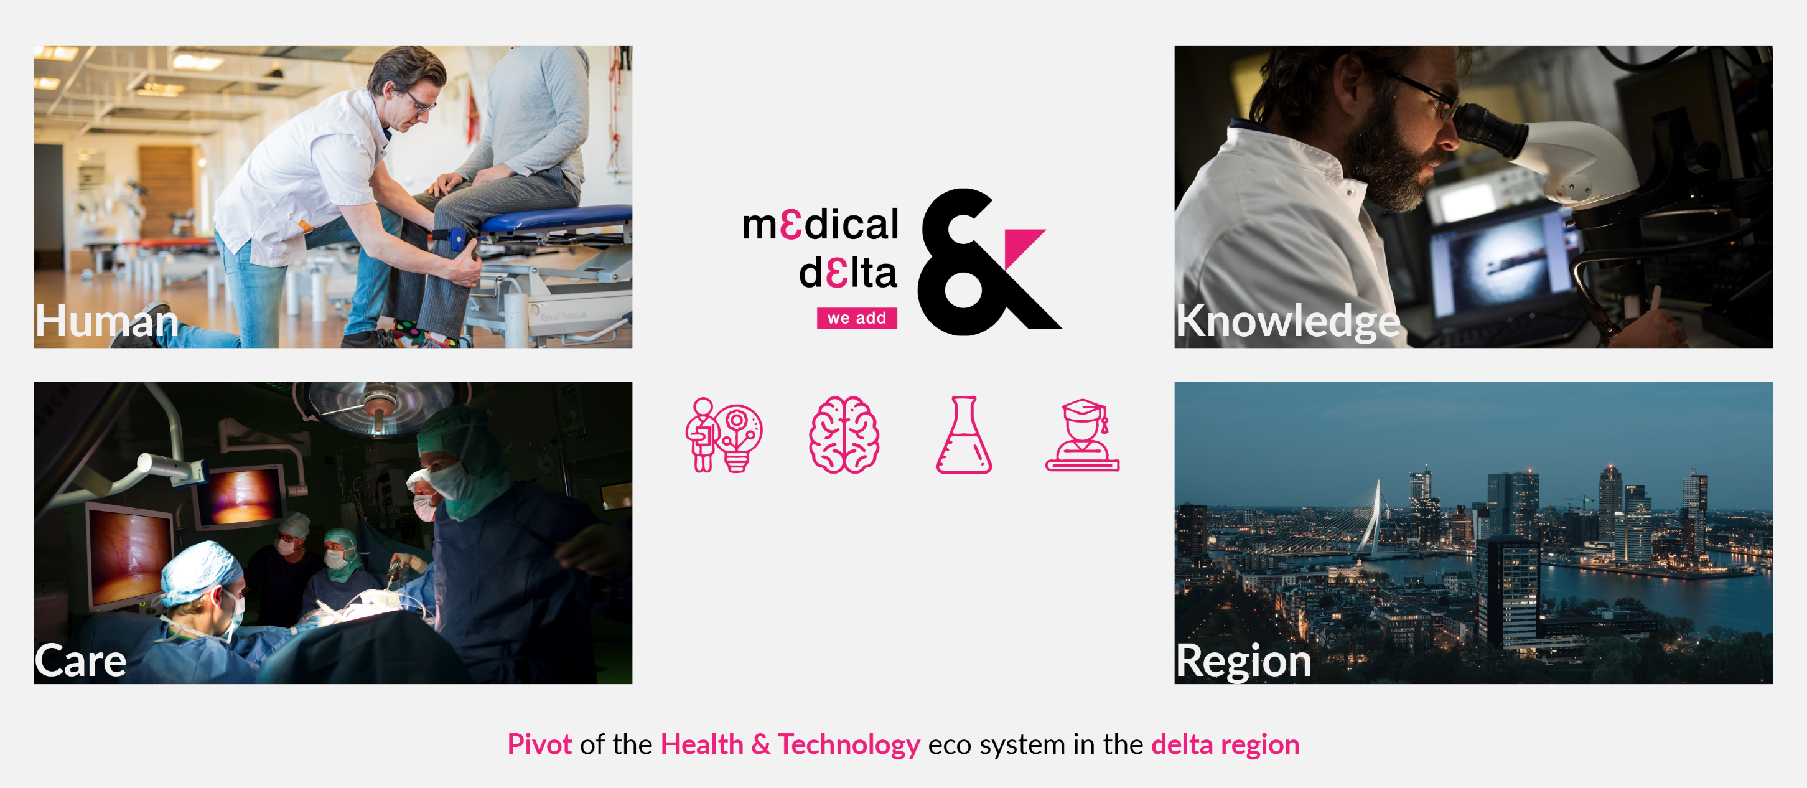
Medical Delta in short
Impact on
⁵⁰⁰
^{Scientists}
¹⁶
^{Programs}
⁹
^{Living labs}
³²
^{Medical Delta}
^{Professors}
Notes:
With this approach, Medical Delta generates impact. Impact on:
• people and their health.
• the care as a whole and on the care professional.
• scientific knowledge.
• the economy of the region
With the region, for the world.
In short, that is what Medical Delta stands for and is committed to.

Slide 7
Overzicht programma’s en labs

Slide 10

Map

Slide 11
Notes:
In this slide you can add a square photo. The photo will automatically be cropped to a size of 14.69 cm high and 16.96 cm wide.
Click on the icon and choose from your files which photo you want to use.

Slide 12
Notes:
You can add a portrait photo in this slide. The photo will automatically be cropped to a size of 14.69 cm high and 9.79 cm wide (ratio 15x10 cm)
Click on the icon and choose from your files which photo you want to use.

Slide 13
Notes:
In this slide you can add a full-frame landscape photo. The photo will automatically be cropped to a size of 14.69 cm high and 33.87 cm wide.
Click on the icon and choose from your files which photo you want to use.

Slide 14
Notes:
You can add 4 horizontal photos in this slide. The photo will automatically be cropped to a size of 7.3 cm high and 16.89 cm wide.
Click on the icon and choose from your files which photo you want to use.

Slide 15


Thank you

